Slide 1
React JS
(jsx)
Lecture- 5

Slide 2
Today’s Agenda
Conditional Rendering
Different Ways Of Conditional Rendering
Examples

Slide 3
What Is Conditional Rendering?
Conditional rendering is a term to describe the ability to render different user interface (UI) markup if a condition is true or false.

Slide 4
What Is Conditional Rendering?
For example: Consider the situation of handling a login/logout button.
Both the buttons have different functions so they will be separate components.
Now, the task is if a user is logged in then we will have to display the logout button and if the user is not logged in then we will have to display the login button.

Slide 5
Different Ways Of Conditional Rendering
The four most useful methods of conditional rendering in React are:
Ternary operator
Short Circuit Evaluation
switch case
if/else

Slide 6
Using Ternary Operator
The conditional (ternary) operator is the only JavaScript operator that takes three operands.
This operator is frequently used as a shortcut for the if statement.
Syntax:
condition ? “This is True” : “This is False”

Slide 7
Exercise
Create an React component that picks up and displays an integer from a list of integers and then displays a message whether the number is even or odd.
Use Ternary Operator

Slide 8
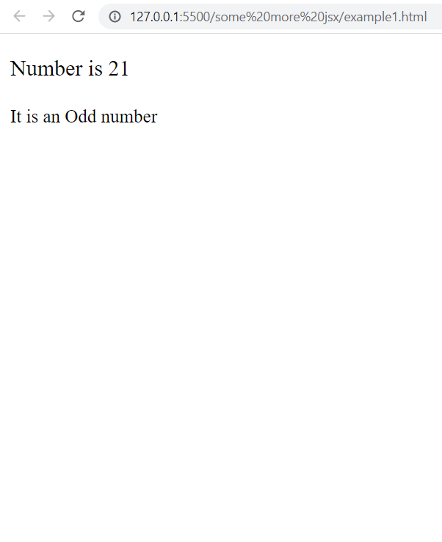
Exercise

Slide 9
Solution 1
<script type="text/babel">
function getNumber() {
const myNums = [10, 5, 3, 1, 11, 6, 8, 21, 7];
const num = myNums[Math.floor(Math.random() * myNums.length)];
return num;
}
function MyNum() {
const num = getNumber();
return (
<div>
<p>Number is {num} </p>
<small>It is an {num % 2 == 0 ? "Even" : "Odd"} number</small>
</div>
);
}
let mydiv = document.querySelector("#root");
ReactDOM.render(<MyNum />, mydiv);
</script>

Slide 10
Solution 2
<script type="text/babel">
function getNumber() {
const myNums = [10, 5, 3, 1, 11, 6, 8, 21, 7];
const num = myNums[Math.floor(Math.random() * myNums.length)];
return num
}
function MyNum() {
const num = getNumber();
return (
<div>
<p>Number is {num} </p>
<small>It is an {num % 2 == 0 ? <span>Even</span> : <span>Odd </span>} number</small>
</div>
);
}
let mydiv = document.querySelector("#root");
ReactDOM.render(<MyNum />, mydiv);
</script>

Slide 11
Exercise
Rewrite the previous React component so that for even numbers it should display the number as well as the message It is an even number and for odd numbers it should just display the number

Slide 12
Solution
<script type="text/babel">
function getNumber() {
const myNums = [10, 5, 3, 1, 11, 6, 8, 21, 7];
const num = myNums[Math.floor(Math.random() * myNums.length)];
return num
}
function MyNum() {
const num = getNumber();
return (
<div>
<p>Number is {num} </p>
<small>{num % 2 == 0 ? <span>You are lucky!!!</span> : <span>{null} </span>} </small>
</div>
);
}
let mydiv = document.querySelector("#root");
ReactDOM.render(<MyNum />, mydiv);
</script>

Slide 13
Using Short Circuit Evaluation
Short circuit evaluation is a technique used to ensure that there are no side effects during the evaluation of operands in an expression.
The logical && helps us specify that an action should be taken only on one condition, otherwise, it would be ignored entirely.

Slide 14
Exercise
Rewrite the previous React component using short circuit evaluation

Slide 15
Solution
<script type="text/babel">
function getNumber() {
const myNums = [10, 5, 3, 1, 11, 6, 8, 21, 7];
const num = myNums[Math.floor(Math.random() * myNums.length)];
return num
}
function MyNum() {
const num = getNumber();
return (
<div>
<p>Number is {num} </p>
{num % 2 == 0 && <small>You are lucky!!</small>}
</div>
);
}
let mydiv = document.querySelector("#root");
ReactDOM.render(<MyNum />, mydiv);
</script>

Slide 16
Using Switch
In JSX, we are able to use switch or if else , but there is a very important rule we must understand .
We cannot directly embed a switch or if-else inside JSX

Slide 17
Wrong Code
This is invalid code and will generate Syntax error: Unexpected token
return (
<div>
<h1>
Hello
</h1>
{
switch(choice){
case 1:
result=........;
break;
...
}
}
</div>
);

Slide 18
Solution
The solution is that the code of switch or if else needs to be moved outside the return statement containing JSX and the result can be stored in a variable and used by JSX

Slide 19
Correct Code
This is now perfect!!
switch(choice){
case 1:
result=…….;
break;
...
}
return (
<div>
<h1>
Hello
</h1>
{ result }
</div>
);

Slide 20
Exercise
Create an React component that picks up and displays an integer from a list of integers and then displays a message whether the number is even or odd.
Use Switch

Slide 21
Exercise
<script type="text/babel">
function getNumber() {
const myNums = [10, 5, 3, 1, 11, 6, 8, 21, 7];
const num = myNums[Math.floor(Math.random() * myNums.length)];
return num;
}
function MyNum() {
const num = getNumber();
let msg = null;
switch (num % 2 == 0) {
case true:
msg = <small>It is Even</small>;
break;
default:
msg = <small>It is Odd</small>;
}

Slide 22
Solution
return (
<div>
<p>Number is {num} </p>
{ msg }
</div>
);
}
let mydiv = document.querySelector("#root");
ReactDOM.render(<MyNum />, mydiv);
</script>

Slide 23
Exercise
Rewrite the previous React component using if-else

Slide 24
Solution
<script type="text/babel">
function getNumber() {
const myNums = [10, 5, 3, 1, 11, 6, 8, 21, 7];
const num = myNums[Math.floor(Math.random() * myNums.length)];
return num;
}
function MyNum() {
const num = getNumber();
let msg = null;
if (num % 2 == 0) {
msg = <small>It is Even</small>;
} else {
msg = <small>It is Odd</small>;
}

Slide 25
Solution
return (
<div>
<p>Number is {num} </p>
{ msg }
</div>
);
}
let mydiv = document.querySelector("#root");
ReactDOM.render(<MyNum />, mydiv);
</script>

Slide 26
Assignment
Rewrite the previous React component so that if the number generated is 6 then it should display Congratulations !! You won and should also display an image called congrats.gif stored in images folder .
For all other numbers , the number must be displayed with the message Sorry! Better luck next time

Slide 27
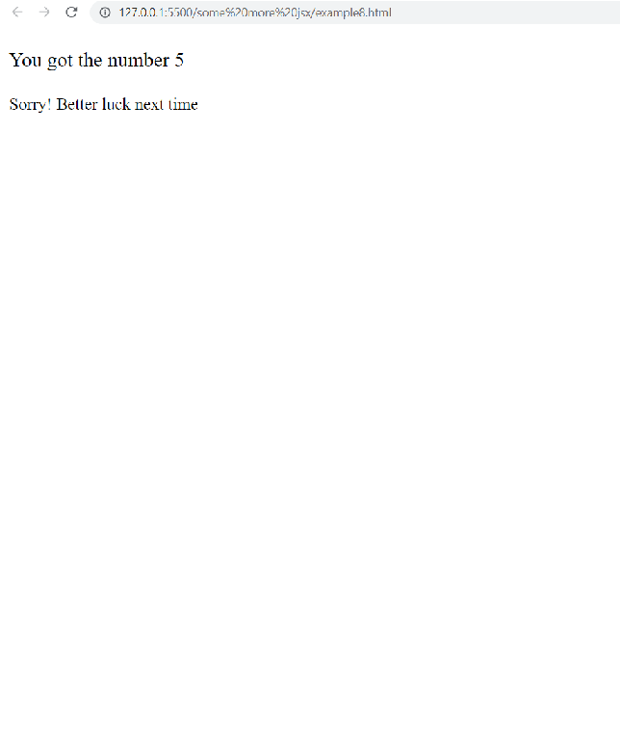
Assignment

Slide 28
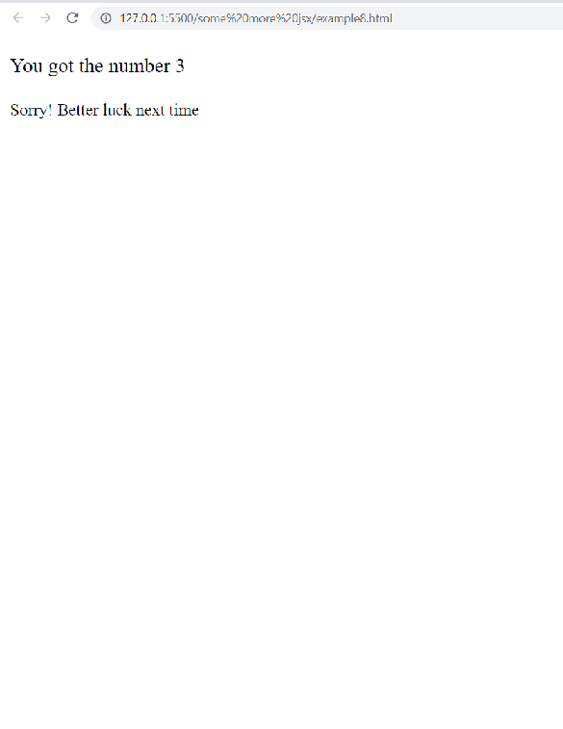
Assignment

Slide 29
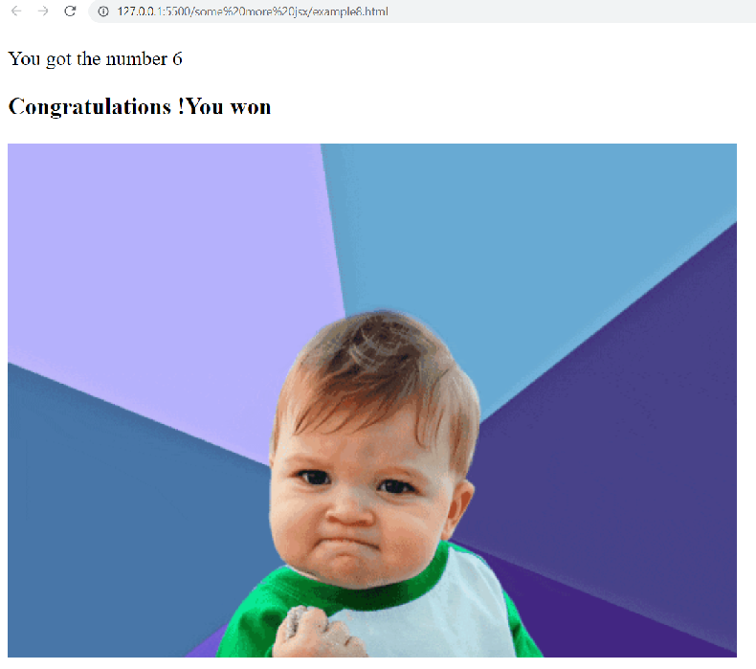
Assignment

